Slide 1
Entity Framework & LINQ
Quick Intro

Slide 2
Entity Framework – why?
MS implmentation of ORM tool
Open sourced – works with ADO.NET – cross platform (.EF Core)
Creates (some) commands – reading, writing, delete, sp, Change tracking
LINQ + EF => query against your domain objects
Advantage of EF: more granular mapping (eg map 1 entity to multiple tables), works will most common DB’s
Relativly easy to use IMHO: focus on your domain model instead of thinking about DB tables etc

Slide 3
Entity Framework: Caveats
Use EF v5. Stable! Default in .NET Core
EF is in the .NET enviroment
.NET 4.0 has NO enums support!
Beware – dont NOT mix .net 4.5 and .Core!
Requires > vs2017 higher (VS2021 – 64 bit coming soon)

Slide 4
Entity Framework: Installation
Either through: Manage Nuget packages in the dependencies in VS 2019 solution
OR:
go to: https://www.nuget.org/packages/EntityFramework/
Copy the package manager console and past into the package manager console in VS2019 and run

Slide 5
Entity Framework: Code First
Primarily interact with the entity objects through the DbContext class
Dbcontext: session with DB and querys (generates) and cruds with DB
Prefably Code First (greenfields) but can also work with existing DB
Leans heavily on your Domain/Model objects; Context class manages the entity objects during runtime eg populate objects, find, read, write and change tracking
Inherent from DbContext and set the exposed entities (domain models collections of) as DbSet<T>
Dbset<T> represents entities(T) in memory; changes to entity will be written to Database table

Slide 6
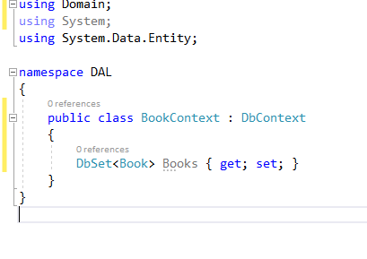
Entity Framework: DbContext

Slide 7
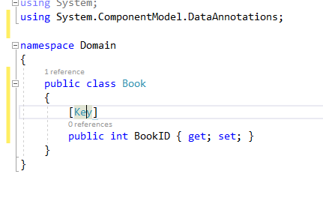
Entity Framework: DbSet and Domain Models
NB: each domain model MUST have an ID property – why?
Naming convention: Either ID or EntityNameID
Note the [Key] data annotation if you are not using Id

Slide 8
Entity Framework: Building our first Context Tutorial 1
Required: VS2019, SQL Server Express, SMSS
Steps:
Create an Entity Model
Create the Context
Manage Domain model through the Dbset
Create Database through migration and update-database

Slide 9
Entity Framework: Adding Entities
Just new – up the object fill properties
Add to context
Savechanges()

Slide 10
Entity Framework: Deleting Entities
EF contains the .Find() method – allows you to get the entity from db (also maps it to the Domain entity)
Remove() marks the entity for deletion once SaveChanges is called

Slide 11
Entity Framework: Modifying Entities
Editing entities is dependant on the case wheteher the entity is being tracked by the context
In disconnected scenario’s (eg web applications) the context has to be notified that the context is modified
Context “tracks” the state of entities through the Changetracker
Commonly used methodology for disconnected scenario:
_customersContext.Entry(customer).State = EntityState.Modified;
_customersContext.SaveChanges();

Slide 12
Entity Framework: Modifying Entities Tutorial 2
CRUD of Entities

Slide 13
Entity Framework: Relationships (= Navigation)
In databases entities can be related to each other; relational view is created through the use of pk and fk. Eg Person table (PersonID) would have N adresses –relationship is maintained through fk’s
Each end of the relationship (usually) has a multiplicity
One to Many: most common
One to One : not uncommon
Many To Many: common
Relationship and navigation is defined in the domain classes........

Slide 14
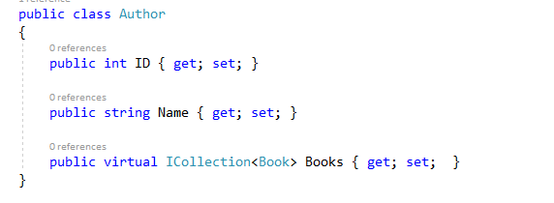
Entity Framework: Navigation 1 : N
Relationships (fk’s) in EF are defined by Navigation properties. EF uses these to map your database schema

Slide 15
Entity Framework: Navigation 1 : N
The fields: ID and Name are called primitive (scalar) types
The field: public virtual ICollection<Book> Books { get; set; } is used by EF to map the relationship between entities.
Each author can author multiple books – so a collection of books can be authored by the same author – relationship property => 1: N

Slide 16
Entity Framework: Navigation N : N
In DB world this relationship would be managed by a join,linking table
For instance: each book can be either hardcover, paperback or EPUB. Each Booktype could have multiple books
Define the relationship by including a collection property on each “side” of the entity
EF will generate the join table on the fly....

Slide 17
Entity Framework: Navigation 1 : 1
How would that look like in code?

Slide 18
Entity Framework: Navigational Properties Tutorial 3
Navigation Properties: building a few (1 : N and N : N)

Slide 19

Entity Framework: Eager and Lazy loading
Lazy loading: child objects (from parent entity) are not loaded automatically. Only after a request (usually LINQ eg .ToList())
Lazy loading: produces several SQL requests
Lazy loading: more resource friendly
Lazy loading: default in EF
Caveat: Lazy Loading introduces the N+1 problem
Eager loading: all entities are loaded at once – parent object and their child objects in one go (force loading => .Include)
Eager loading:

Slide 20
Entity Framework: Eager and Lazy loading
When to use Lazy Loading:
One to many relationships -> When you dont require the child object immediately
Good example: pagination (Web Api or MVC)
When to use Eager Loading:
Relationships between objects aren’t huge – object graph is relative small
Reduce calls to the Server
Good example: article and product category

Slide 21
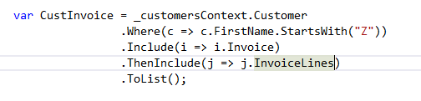
Entity Framework: ThenInclude
EF enables you to “drill” through many levels of related entities (usually collections of)
Eg:

Slide 22
Entity Framework: Eager loading Tutorial 4

Slide 23
Entity Framework: Data Annotations
Used to configure domain classes -> reflected to DB
DataAnnotations: attributes that influencte size and nullability of columns; most commonly used:
Key
Timestamp
Required
MinLength
MaxLength
StringLength

Slide 24
Entity Framework: Data Annotations Schema
DataAnnotations.Schema: denote the schema of a DB
Table
Column
Index
ForeignKey
NotMapped <= mostly calculated fields <=nice one!

Slide 25
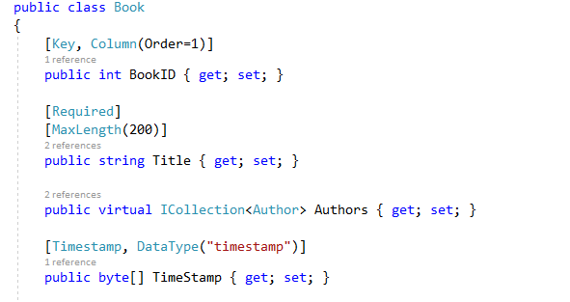
Entity Framework: Annotation Example
Note: some annotations are used by MVC to derive UI based validation (.js)

Slide 26
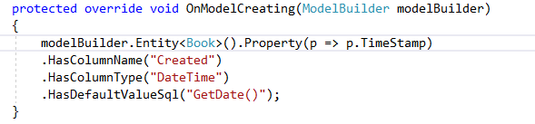
Entity Framework: Fluent Api Configuration
Advanced and granular way to further refine the data annotations
HUGE Pro (IMHO) : configuration is moved away from the domain classes – either in Context or IEntityTypeConfiguration<TEntity>
Fluent API configuration is done in the Context class through the method: OnModelCreating(ModelBuilder modelbuilder)
Method calls are chained together:

Slide 27
Entity Framework: Data Annotations Tutorial 5
Applying Annotations

Slide 28
Entity Framework: LINQ to Entities
A powerfull advantage of EF is the ability to query against the EF through LINQ.
The querys operate againt the DbSet<T> and acces data from the DB
The sql queries are generated by LINQ and EF
Two options for querying the EF: method syntax or query syntax:
//method syntax
var Customer = _customersContext.Customer
.Where(c => c.LastName == "Stardust")
.FirstOrDefault<Customer>();
//query syntax
var query = from st in _customersContext.Customer
where st.LastName == "Billy"
select st;

Slide 29
Entity Framework: LINQ to Entities
Usefull ones:
First()
FirstOrDefault() -> NB!!
Single()
ToLst() -> NB!!
Count()
Min()
Max()
Last()
Average()
Any()

Slide 30
Entity Framework: LINQ to Entities
Projection: transfer object and its data to a new object (concrete type) which only contains the required objects(Mostly DTO’s en VM).
Uses the Select method and a lambda expression to map the fields to a new type (or anonymous type)
Eg anonymous type:
var result = Cust.Select(r => new {ID = c.id, Name = c.name});

Slide 31
Entity Framework: LINQ to Entities Tutorial 6
Experimenting with Find(), Sort(), Projection and SelectMany

Slide 32
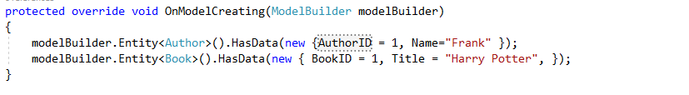
Entity Framework: Tips
Seeding Data:
If queries are slow its often beneficial to move the query to stored procedures
LINQ is not limited to EF – classes inherited from IEnumerable<T> and IQueryable<T> can be “LINQ-ed”
LINQpad: programmers LINQ playground
Download : https://www.linqpad.net/

